Slide 1
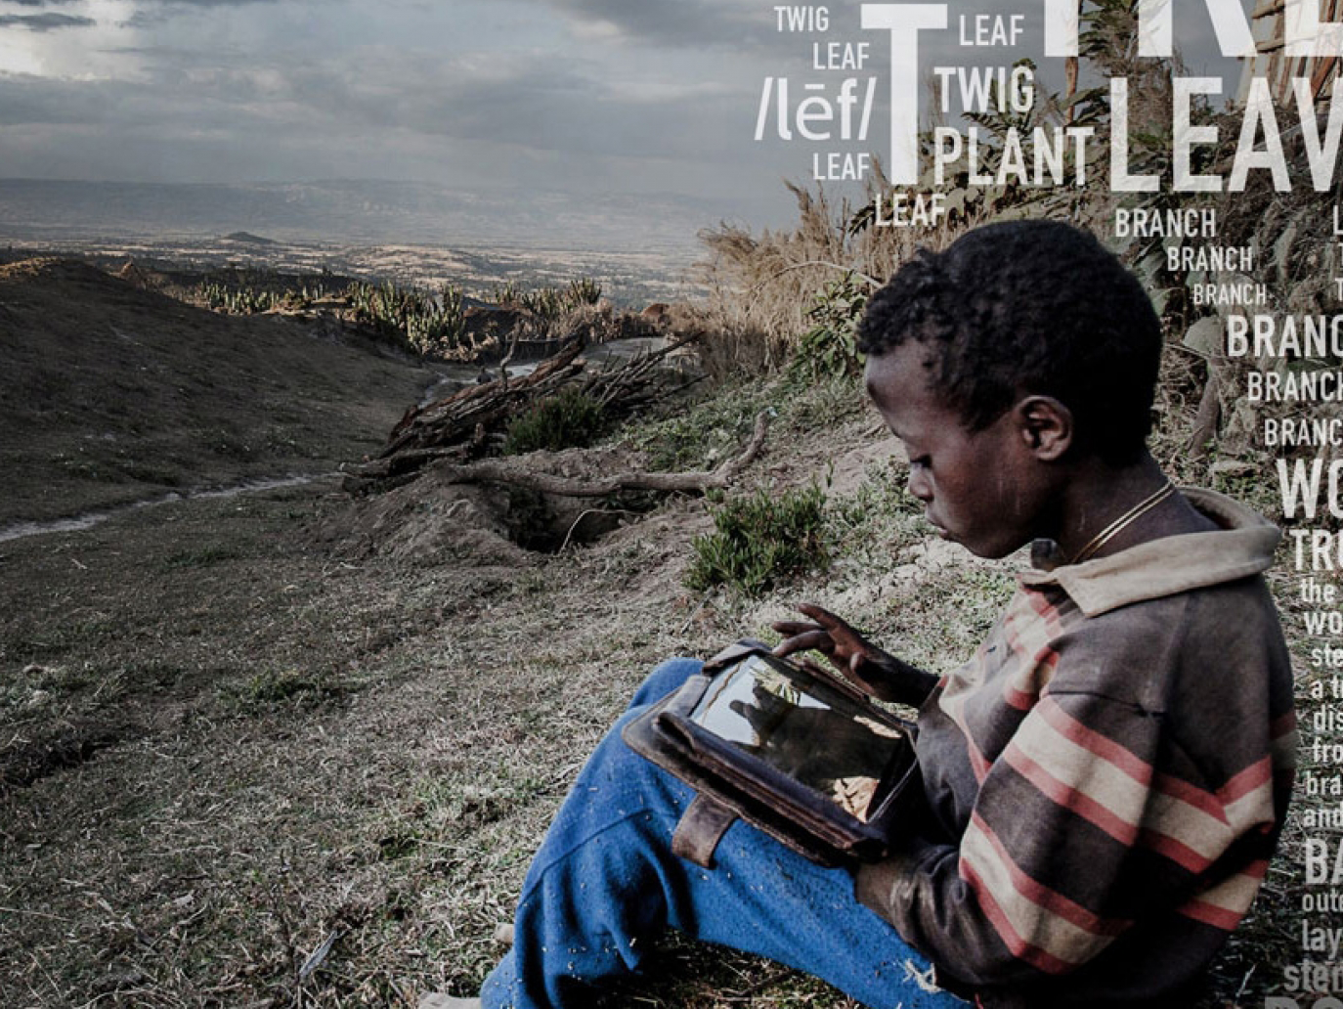
What is the Global Learning XPRIZE?
$15M competition for open-source Android tablet app that enables children 7-10 without access to formal education to learn reading, writing, and arithmetic.
11/2016: English & Swahili apps due; 5 finalists win $1M.
2017-18: XPRIZE tests Swahili apps in 175 villages.
2019: App with highest total gains wins $10M Grand Prize.

Slide 2
Why should Carnegie Mellon Compete?
Perfect alignment to:
Simon Learning Initiative
Goal of positive global impact
Culture of interdisciplinary collaboration
Emphasis on empirical validation
Experience in developing reading and math tutors
Student participation in research and course projects
Visibility
Exciting competition for noble goal
Potential to win $1M or even $10M
Great for Carnegie Mellon brand
Inspire public
Attract students
Carnegie Mellon University

Slide 3
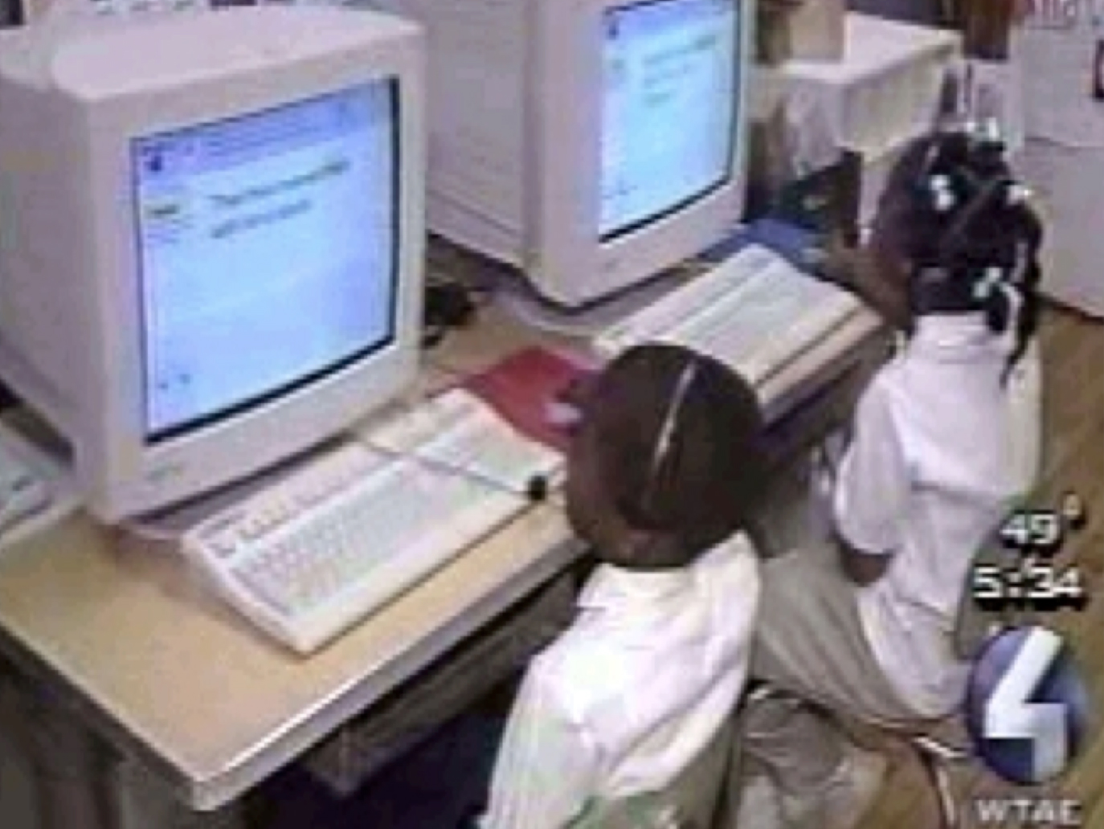
Pittsburgh school
What is Project LISTEN’s Reading Tutor?
Child reads, computer listens (using speech recognition)
Used by thousands of children at school on Windows PCs
One of NSF’s Nifty Fifty projects
Carnegie Mellon University
Notes:
General comment: make picture captions more prominent?

Slide 4
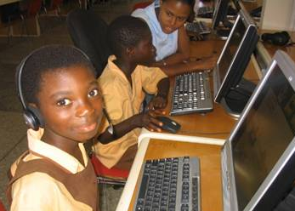

Internet Café in Accra, Ghana
Impact of Project LISTEN’s Reading Tutor
Children in controlled studies in USA, Canada, Ghana, India:
Outgained independent practice and some classroom teaching
Tied human tutoring on several skills
Research in 100+ publications including Best Paper awards
Licensees now productizing Reading Tutor and reading game

Slide 5
Peer-Reviewed Publications:
Types of Project LISTEN research studies
Test overall effects by comparing pre- to post-test gains to control treatment(s)
Reading Tutor rivaled human tutors in some skills (JECR03)
Reading Tutor beat Sustained Silent Reading (JECR07, JECR13)
Reading Tutor helped ELLs in Canada (IDEC09), Ghana (ITID10), India (Dev10)
Assess student skills, validating on performance in tutor and on gold standard tests
Cloze questions predict vocabulary and comprehension (TICL04)
Prosody predicts proficiency (CALICO04, TICL04, TSLP11)
LR-DBN subskill tracing cuts prediction error in half (*EDM12)
Identify important variables using correlational analyses
Gains decrease with time spent picking stories (ITS02)
Labs average higher usage than classrooms (Scale-up 07)
* Best Paper or Nominee

Slide 6
Peer-Reviewed Publications:
Types of Project LISTEN research studies
Compare types of practice using growth curve micro-analyses
Wide reading builds fluency faster than rereading (SSSR05, ITS08)
Students gained more from stories they picked (AIED07)
Evaluate tutor interventions using randomized within-subject experiments
Test effects of vocabulary intervention on taught vs. untaught words (ETS02)
Compare effects of tutor help on next encounter of word (SSSR04, ICALL04, *AIED13)
Mine tutor logs to discover useful knowledge
Identify prosodic indicators of reading gains (*FLAIRS12)
* Best Paper or Nominee

Slide 7
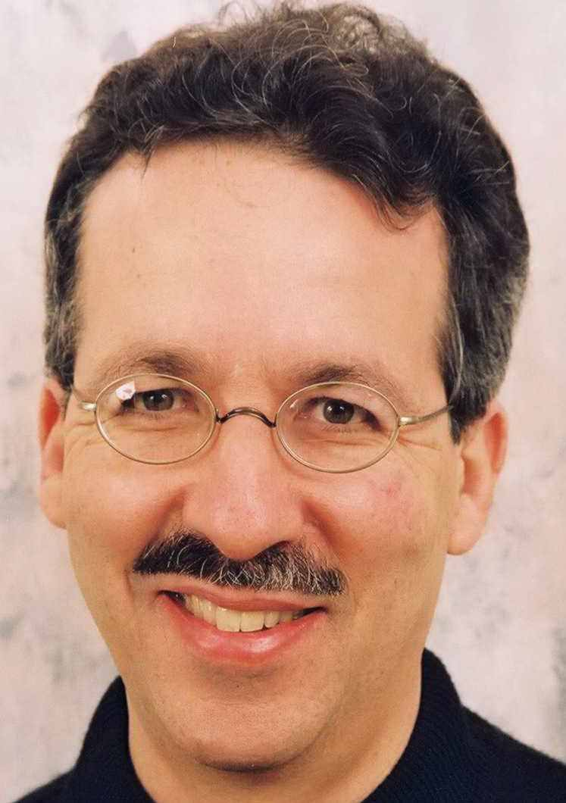
Who is Jack Mostow?
Leader of Carnegie Mellon team in XPRIZE Global Learning Challenge
Founder and Director of Project LISTEN
Emeritus Research Professor of Robotics, Machine Learning, Language Technologies, and Human-Computer Interaction
Steering Committee, PIER (Program in Interdisciplinary Educational Research)
Harvard AB cum laude in Applied Math
Carnegie Mellon PhD in Computer Science
Allen Newell Award for Research Excellence
President, International AI in Education Society

Slide 8
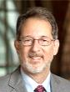


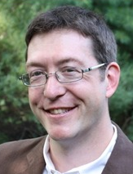
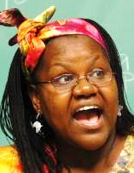

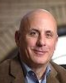

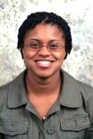
Who is Already Helping? Faculty, staff, …
Richard Scheines, Simon Learning Initiative: funding
Ken Koedinger, HCII: math education
Amy Ogan, HCII: cultural factors
Norman Bier, SLI Exec. Director: implementation
Leonora Kivuva, U. of Pittsburgh: Swahili
John Stamper, HCII: data science
Gerry Balbier, BrainHUB: foundations
Vincent Aleven, HCII: cognitive tutors, motivation
Ayorkor Korsah, Ashesi University: Ghana studies
Notes:
Initial advice:
Matt Kam, LearningYogi.org: field studies
Sumantra Roy, LearningYogi.org: literacy games
Red Whittaker: competitions

Slide 9
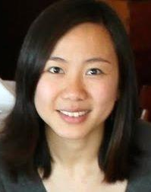

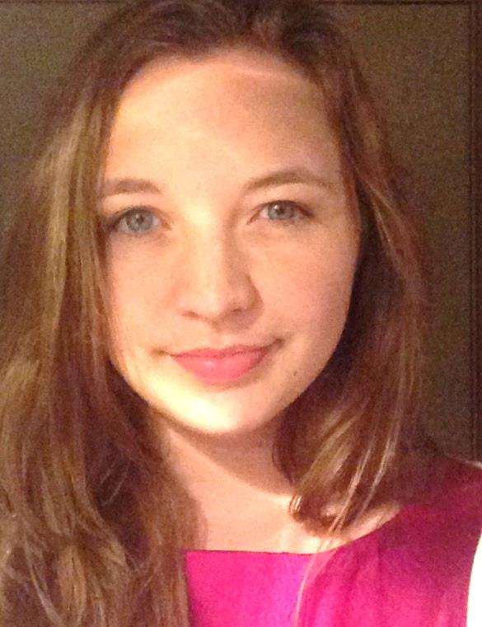

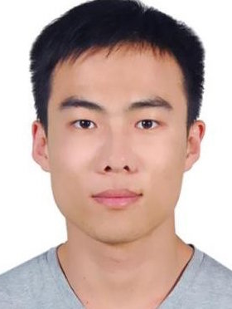
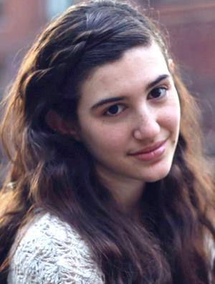
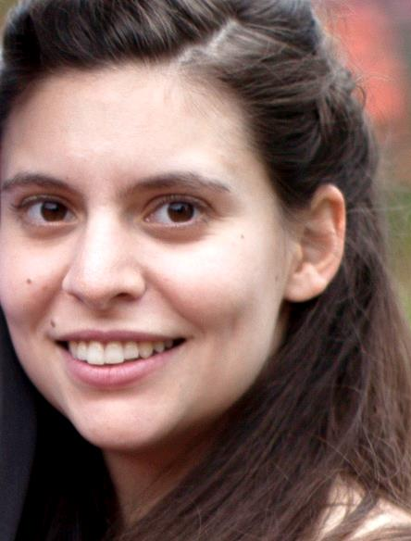

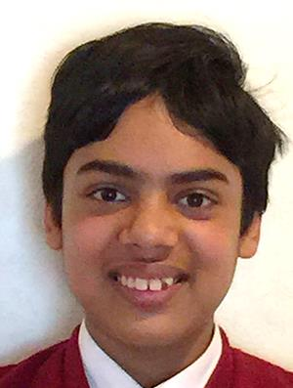
Who is Already Helping? … grads, students
Ran Liu, Psychology: cognitive modeling
Rika Antonova, Robograd: machine vision
Rebecca Smith, Decision Science: numeracy tutor
Derek Lomas, Playpower Labs: math games
Haonan Sun, LTI: speech recognition
Sara Remi Fields, Design: visual design
Vishnu Rajan Tejus, Stanford online: gesture input
Eliane Stampfer, HCII:
grounded feedback
Varun Pant, Mechanical Eng.: math games
Notes:
Also: Jessica Hammer, ETC&HCII: games
Safinah Ali: ??
?: writing tutors
Iris Hu, Beijing: ??
Martin Van Velsen, Jonathan Sewall: CTAT

Slide 10
Educational targets
Literacy (EGRA = Early Grade Reading Assessment)
Alphabet: See letter, say name
Phonemic awareness: Hear word, say initial sound
Listening comprehension: Hear story, answer questions
Sight words: See common word, say it
Decoding: See non-word, say it
Fluency: See text, read aloud
Reading comprehension: Read text, answer questions
Copying/dictation: See or hear letter/word/sentence, write it
Sentence writing: Given a prompt, write a complete sentence
Numeracy (EGMA = Early Grade Math Assessment)
Number identification: See number, say it
Number discrimination: See two numbers, pick larger number
Number pattern identification: See series, fill in missing number
Addition (and subtraction): See 1- or 2-digit numbers, add them
Word problems: Hear word problem, say answer

Slide 11
What assets will we leverage?
Project LISTEN’s Reading Tutor based on $$$ of R&D
Carney Labs is porting Reading Tutor to Android tablets
PlayPower Labs is porting its online math games
Students are using CTAT to develop tutors
U. of Massachusetts will provide its Mathspring content
Colleagues here and elsewhere are contributing expertise
Notes:
Add visuals

Slide 12
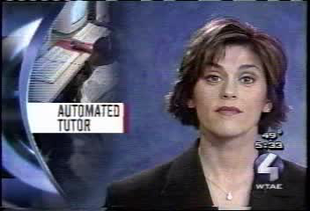
Notes:
High-bandwidth connection? Download video as high-resolution .mpg file (23MB). Low-bandwidth connection? Download video as low-resolution Windows Media File (4MB).

Slide 13
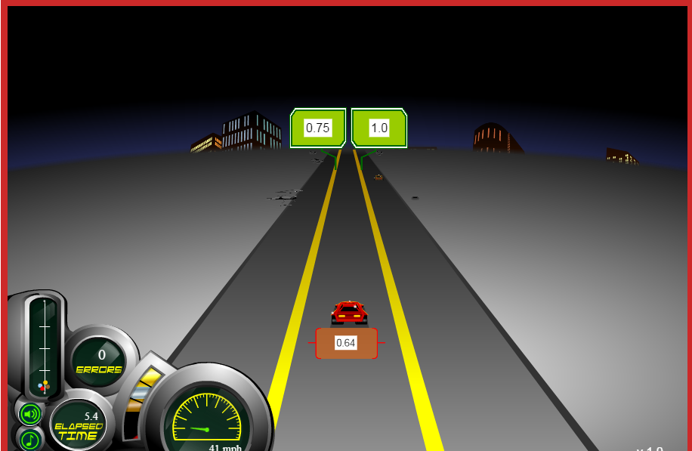
www.fluencychallenges.org

Slide 14
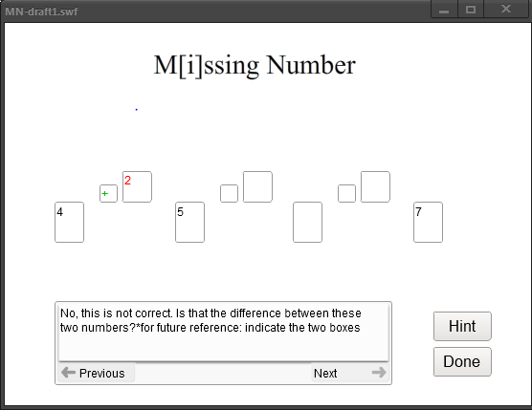
Example: Missing Number Tutor
Scaffolding to notice patterns
Task is to infer missing number
Need to replace text with spoken feedback
Need to trigger help when stuck
Need to point with gestures or highlighting
Eliminate text labels kids might be unable to read
Need to eliminate Done button?

Slide 15
Whom do we need? (@~$50–100+K/year)
Team leader: set vision, build team, raise funds
Developer: build rich code needed for high gains
Designer: make apps usable & engaging for high usage
Tester: assure software availability & correct behavior
Project manager: keep development on time, on track
Materials developer: create instruction, measure gains
Linguist: build resources for effective instruction
Analyst: mine logged data to increase learning gains

Slide 16
How will we proceed?
Raise funds ASAP to hire staff.
Assemble interdisciplinary team.
Recruit partners in USA and Africa.
Identify cultural considerations.
Specify app goals, SW architecture, development plan.
Carney Labs adapting Reading Tutor for tablet.
Use student projects to prototype and test components.
Agile development: start simple, add features.
Plan for growth: anticipate translation to Swahili.
Add materials to meet additional educational targets.
Test early and often.

Slide 17
Milestones
2015
April, 2015: Registered Carnegie
Mellon University
APR
MAY
JUN
JUL
AUG
SEP
OCT
NOV
DEC
May, 2015: Recruited faculty,
students, and companies
3
2016
FEB
MAR
APR
MAY
JUN
JUL
AUG
SEP
OCT
NOV
DEC
August, 2015: Raise $$, hire staff
November, 2016: Teams submit English & Swahili versions
December, 2016: XPRIZE
selects five Finalists to win $1M
2017
FEB
MAR
APR
MAY
JUN
JUL
AUG
SEP
OCT
NOV
DEC
June, 2017: Finalists submit revised Swahili versions
July, 2017 – December 2018: XPRIZE field-tests apps, sends
data; teams can update apps
2018
FEB
MAR
APR
MAY
JUN
JUL
AUG
SEP
OCT
NOV
DEC
January – February 2019: XPRIZE analyzes and certifies
results
March 2019: XPRIZE announces $10M Grand Prize Winner
2019
FEB
MAR
APR
Notes:
April, 2015 – Registered Carnegie Mellon
May, 2015 – Recruiting faculty, students, and companies
June, 2015 – Raise funds to hire!

Slide 18
Return on investment: impact!
In any case:
Students: opportunities for research and course projects
Knowledge: lessons on automated tutors in other cultures
Code: for use by community or commercial partners
If chosen as Finalist:
Children: gains in reading, writing, and math
Data: logged usage, interactions, and gains
Knowledge: experience with deployed tutor in Africa
University: visibility, recruitment, prize money

Slide 19
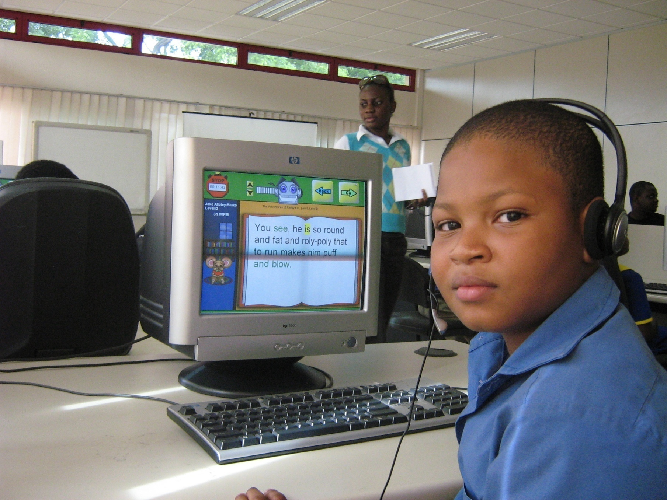
Kofi Annan Technology Centre, Ghana
For More Information
XPRIZE:
learning.xprize.org
Project LISTEN:
projectlisten.org
Jack Mostow:
mostow@cs.cmu.edu

